Slide 1
Supervised learning for transcription factor binding
GENOME 541
Prof. William Stafford Noble
University of Washington

Slide 2
Di-mismatch kernel SVM
Phaedra Agius, Aaron Arvey, William Chang, William Stafford Noble, Christina Leslie. “High Resolution Models of Transcription Factor-DNA Affinities Improve In Vitro and In Vivo Binding Predictions.” PLOS Computational Biology, 2012.
William Noble. “What is a support vector machine?” Nature Biotechnology, 2006.

Slide 3
Supervised learning of TF binding specificities

Slide 4
The SVM is a hyperplane classifier
+
+
+
+
+
-
-
+
Locate a plane that separates positive from negative examples.
+
-
+
-
+
+
-
-
-
-
-
+
-
-
-
+
+
-
+
-
-
-
Focus on the examples closest to the boundary.

Slide 5
Understanding SVMs requires grasping four key concepts
Separating hyperplane
Maximum margin hyperplane
Soft margin
Kernel function (input space → feature space)

Slide 6
The data natively resides in the input space
gene2
1
3
gene1 gene2
patient1 -1.7 2.1
patient2 0.3 0.5
patient3 -0.4 1.9
patient4 -1.3 0.2
patient5 0.9 -1.2
2
4
gene1
5
Rather than TF binding, I use a gene expression example drawn from the Nature Biotech tutorial.

Slide 7
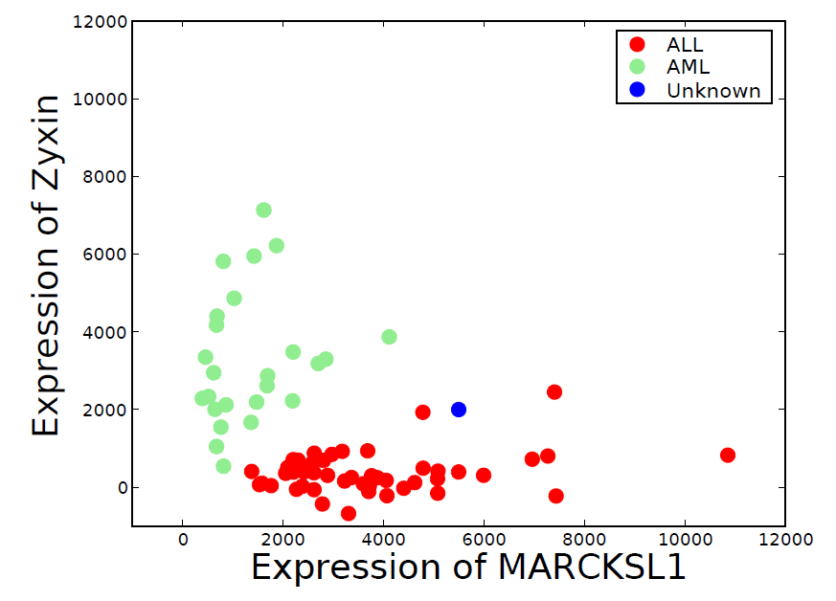
Each subject may be thought of as a point in an m-dimensional space.

Slide 8
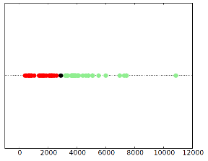
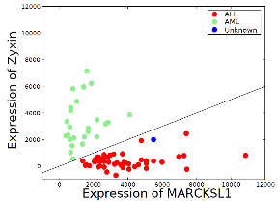
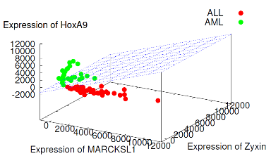
Concept #1: The separating hyperplane lies between the two classes of points
Construct a hyperplane separating ALL from AML subjects.

Slide 9
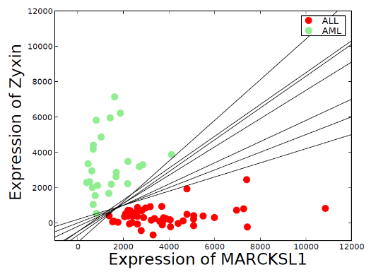
For a given set of data, many possible separating hyperplanes exist.

Slide 10
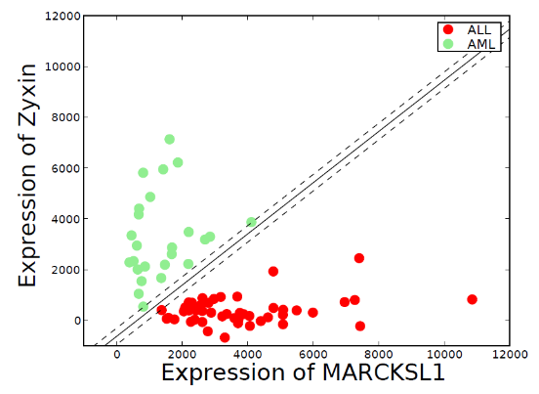
Concept #2: The maximum margin hyperplane is farthest from any training example

Slide 11
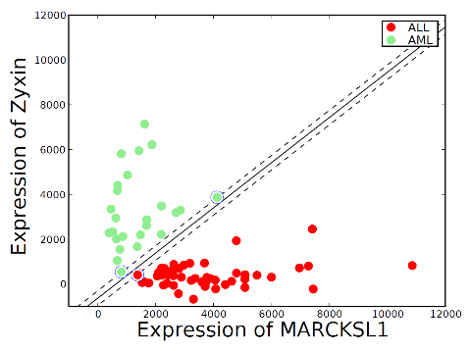
Support vectors are the training examples that define the hyperplane
The location of the hyperplane is specified via a weight associated with each training example.
Examples near the hyperplane receive non-zero weights and are called support vectors.

Slide 12
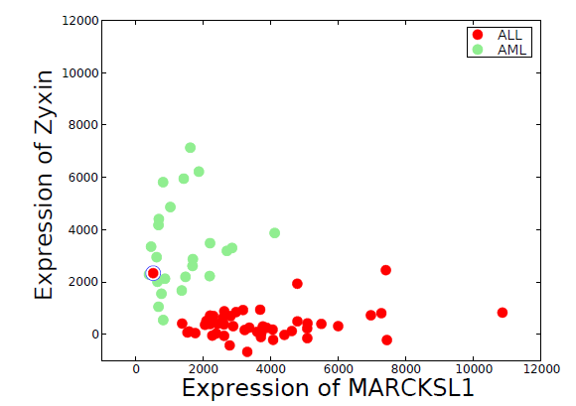
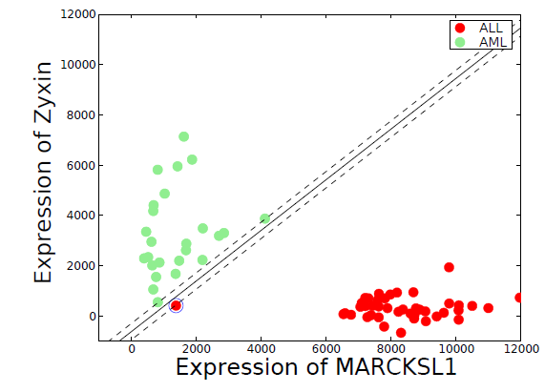
Incorrectly measured or incorrectly labeled data is challenging
No separating hyperplane exists
The separating hyperplane does not generalize well

Slide 13
Concept #3: Soft margin penalizes misclassifications
When no separating hyperplane exists, the SVM uses a soft margin hyperplane with minimal cost.
A parameter C specifies the relative cost of a misclassification versus the size of the margin.

Slide 14
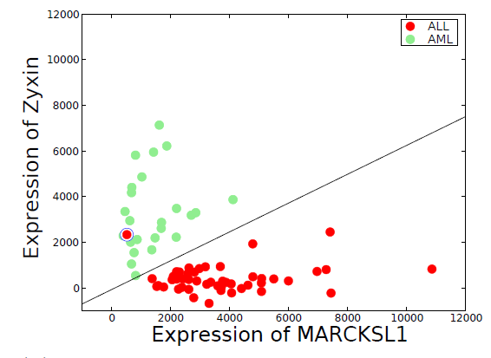
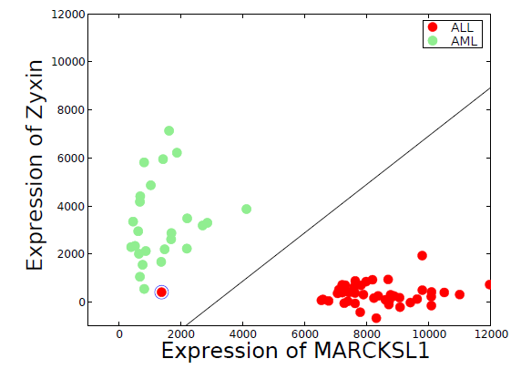
Soft margin handles noisy training data

Slide 15
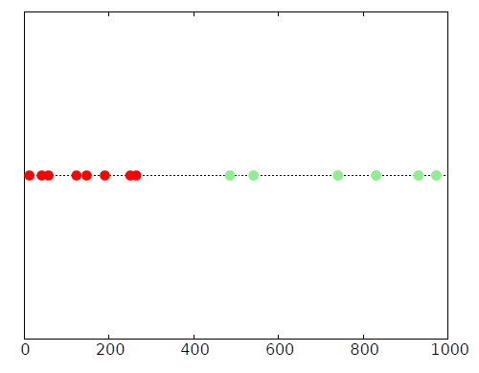
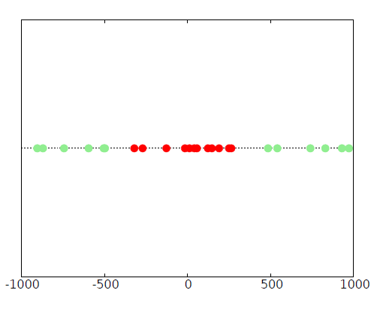
Sometimes data cannot be separated by a hyperplane
In 1D, a hyperplane is just a point.

Slide 16
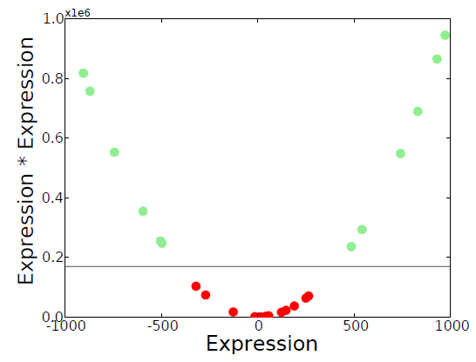
We can mathematically add a dimension to separate previously non-separable data

Slide 17
SVMs map the data from the input space to a higher-dimensional feature space.
Input space
Feature space

Slide 18
Concept #4: Adding a kernel function allows the SVM to be nonlinear
The kernel function replaces the dot product operation
Consider two training examples A = (a₁, a₂) and B = (b₁, b₂).
Define a mapping from input space to feature space: Φ(X) = (x₁x₁, x₁x₂, x₂x₁, x₂x₂)
Let K(X,Y) = (X • Y)²
Write Φ(A) • Φ(B) in terms of K.

Slide 19
Kernel function as dot product
Φ(A) = (a₁ a₁, a₁a₂, a₂a₁, a₂a₂)
Φ(B) = (b₁ b₁, b₁b₂, b₂b₁, b₂b₂)
Φ(A) • Φ(B)
= (a₁ a₁, a₁a₂, a₂a₁, a₂a₂) • (b₁ b₁, b₁b₂, b₂b₁, b₂b₂)
= a₁a₁b₁b₁ + a₁a₂b₁b₂ + a₂a₁b₂b₁ + a₂a₂b₂b₂
= a₁b₁a₁b₁ + a₁b₁a₂b₂ + a₂b₂a₁b₁ + a₂b₂a₂b₂
= (a₁b₁ + a₂b₂) (a₁b₁ + a₂b₂)
= [(a₁, a₂) • (b₁, b₂)]²
= (A • B)²
= K(A, B)

Slide 20
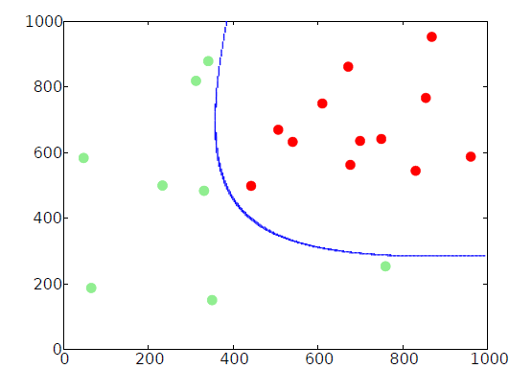
Separating in 2D with a 4D kernel

Slide 21
“Kernelizing” Euclidean distance

Slide 22
Kernel function
The kernel function plays the role of the dot product operation in the feature space.
The mapping from input to feature space is implicit.
Using a kernel function avoids representing the feature space vectors explicitly.
Any continuous, positive semi-definite function can act as a kernel function.
Proof of Mercer’s Theorem: Intro to SVMs by Cristianini and Shawe-Taylor, 2000, pp. 33-35.

Slide 23
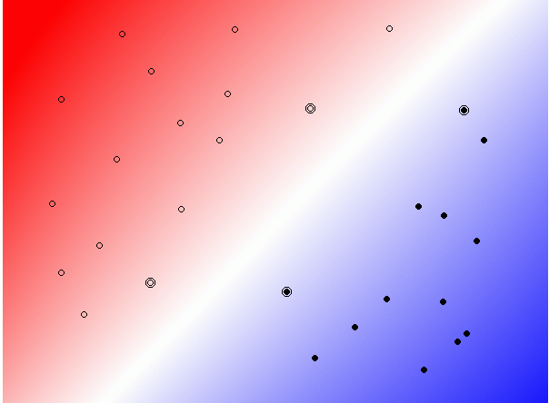

Slide 24
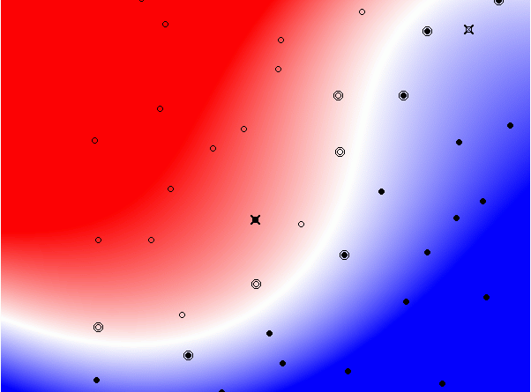

Slide 25
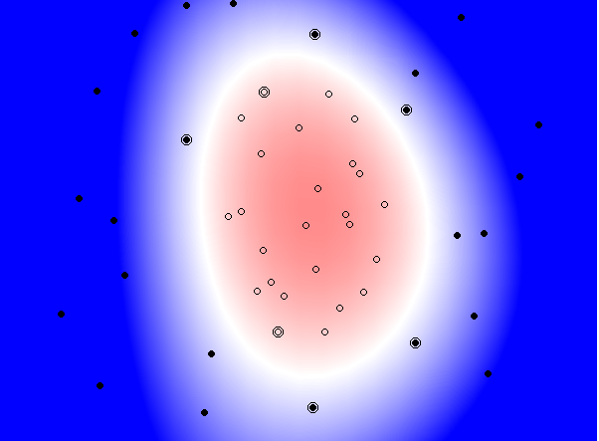

Slide 26
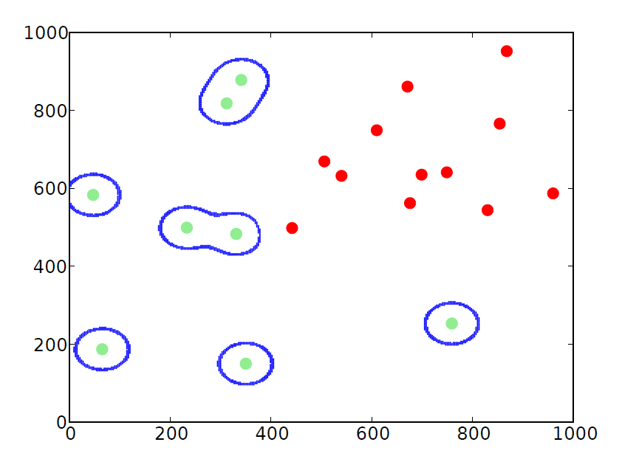
Overfitting with a Gaussian kernel

Slide 27
The SVM learning problem
Input: training vectors x_{i} … x_{n} and labels y_{i} … y_{n}.
Output: bias b plus one weight w_{i} per training example
The weights specify the location of the separating hyperplane.
The optimization problem is a convex, quadratic optimization.
It can be solved using standard packages such as MATLAB.

Slide 28
SVM prediction architecture, with kernel
Query = x
x₁
x₂
x₃
...
x_{n}
k
k
k
k
w₂
w₃
w_{n}
w₁

Slide 29
Sequence kernels
>ICYA_MANSE
GDIFYPGYCPDVKPVNDFDLSAFAGAWHEIAKLPLENENQGKCTIAEYKY
DGKKASVYNSFVSNGVKEYMEGDLEIAPDAKYTKQGKYVMTFKFGQRVVN
LVPWVLATDYKNYAINYNCDYHPDKKAHSIHAWILSKSKVLEGNTKEVVD
NVLKTFSHLIDASKFISNDFSEAACQYSTTYSLTGPDRH
>LACB_BOVIN
MKCLLLALALTCGAQALIVTQTMKGLDIQKVAGTWYSLAMAASDISLLDA
QSAPLRVYVEELKPTPEGDLEILLQKWENGECAQKKIIAEKTKIPAVFKI
DALNENKVLVLDTDYKKYLLFCMENSAEPEQSLACQCLVRTPEVDDEALE
KFDKALKALPMHIRLSFNPTQLEEQCHI
We cannot compute a scalar product on a pair of variable-length, discrete strings.

Slide 30
Spectrum-based feature map
Idea: feature map based on spectrum of a sequence
The k-spectrum of a sequence is the set of all k-length contiguous subsequences that it contains
Feature map is indexed by all possible k-length subsequences (“k-mers”) from the alphabet of amino acids.
Dimension of feature space = 20^{k}

Slide 31

k-spectrum feature map
For sequence x, the i^{th} element of feature vector F_{k}(x) = count of the number of occurrences of the i^{th} k-mer in x.
Kernel is $K_{k}\left(x,y\right)=F_{k}\left(x\right){∙F}_{k}\left(y\right)$
AKQDYYYYEI
( 0 , 0 , … , 1 , … , 1 , … , 2 )
AAA AAC AKQ KQD YYY
Notes:
FIXME

Slide 32
Dimismatch kernel
Count the number of matching dinucleotides.
4 non-consecutive mismatches yields 6/12.
Favors adjacent matches.
4 consecutive mismatches yields 7/12.
Comparing θ_{i} and s_{j}, boldface and underscores correspond to mismatches.

Slide 33
SVM improves over PSSM on PBM data
PSSMs trained using protein-binding microarrays
Performance measure is detection of the top 100 probes.
Training on one array design and testing on a second array design for the same factor.

Slide 34
SVM improves over PSSMs on ChIP-seq data

Slide 35
DeepSEA
Zhou and Troyanskaya. “Predicting effects of noncoding variants with a deep learning-based sequence model.” Nature Methods 2015.

Slide 36
Sequence-to-function models predict multiple epigenomic signals from DNA sequence
ATAC-seq in fibroblast
H3K27ac in H1-hESC
RNA-seq in cardiomyocyte
Neural
Network
DeepSEA (Zhou et al 2018)
Basenji (Kelley et al 2018)
Enformer (Avsec et al 2021)
Borzoi (Linder et al 2024)
ACGAGTTCGATGTGAGCGATGCAACACATCGATGCATACCGACGACTTAGAACAAAGTTACGAGTTGAGCAGTACGATCGGATCTAGGACC
Credit: Surag Nair
Notes:
As you all know, A popular framework for learning cis-regulatory syntax are sequence to function models that take in DNA and predict some experimental data
Because a lot of the cis-regulatory grammar is shared across cell types and assays, a common design decision today is to make DL models multi task, meaning given a sequence they will make predictions across 100s Or thousands of tasks

Slide 37
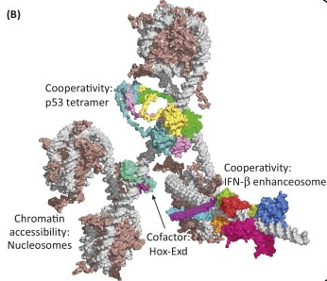
What factors might we consider beyond the PSSM?
DNA physical shape
Variable gaps
Cooperativity between TFs
Nucleosome interactions

Slide 38

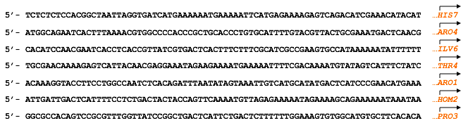
Supervised framework
CTCF binds in this sequence?
CTCF ChIP-seq peak sequence (~150 bp)

Slide 39
Sequence representation: one-hot encoding
One-hot encoding
1 0 0 0 0 1 0 0 0 1 0 0 0 0 0 1 0 0 1 0 …
A
C
C
G
T
Input sequence
ACCGTCGGTATAGGCTTATAAATCTCGGGATACCGTCGGTATAGGCTTATAA

Slide 40
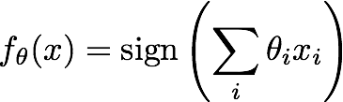
Idea #1: linear classifier
1 0 0 0 0 1 0 0 0 1 0 0 0 0 0 1 0 0 1 0 …
A
C
C
G
T
One-hot encoding

Slide 41




Neural networks can process input through multiple layers
1 0 0 0 0 1 0 0 0 1 0 0 0 0 0 1 0 0 1 0 …
A
C
C
G
T

Slide 42
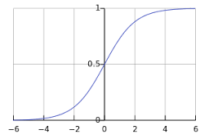
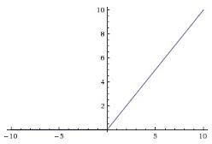
A nonlinear activation function is applied at each layer
Logistic function:
Rectifier-linear (ReLu) function:
1 0 0 0 0 1 0 0 0 1 0 0 0 0 0 1 0 0 1 0 …
A
C
C
G
T

Slide 43
Internal layers capture higher-order features
Output
Higher-level intermediate features (binding sub-domains, cofactor binding)
Intermediate features
(DNA shape)
Raw features
1 0 0 0 0 1 0 0 0 1 0 0 0 0 0 1 0 0 1 0 …
A
C
C
G
T

Slide 44
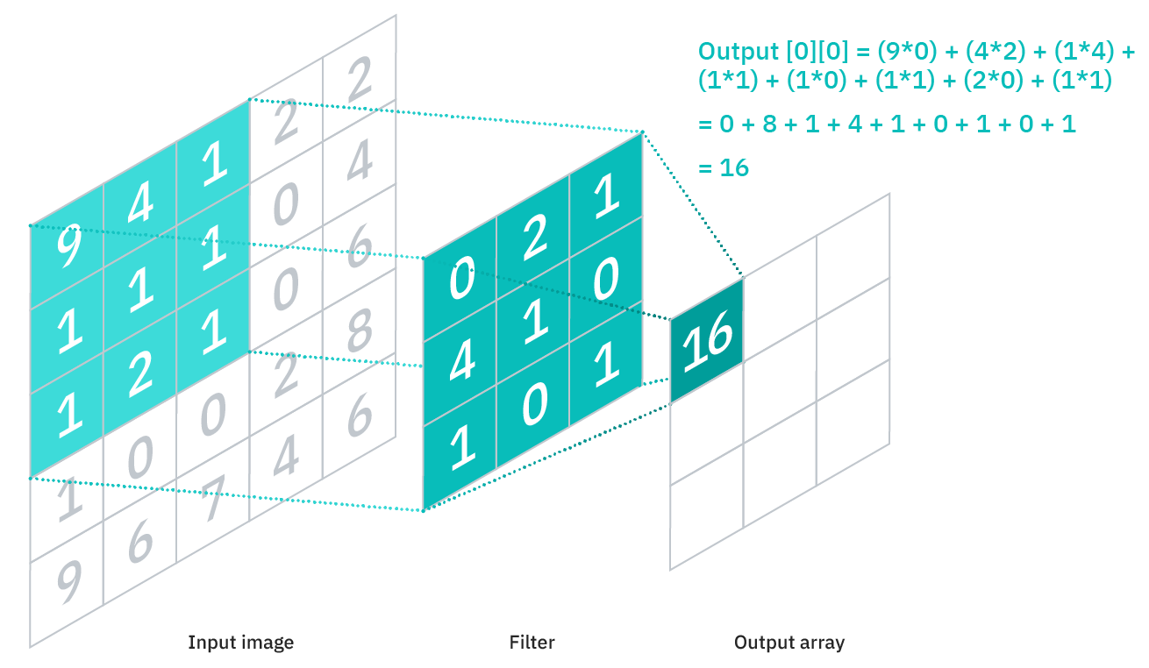
A convolutional network applies the same function across portions of the input
https://www.ibm.com/cloud/learn/convolutional-neural-networks

Slide 45
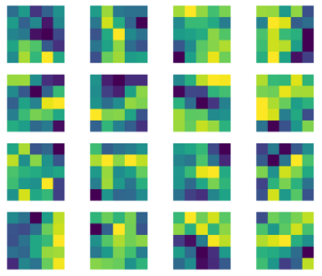
A single network may contain multiple convolutional filters
Each filter captures a different feature of the input
A collection of 5x5 filters for a digit recognizer
https://medium.com/dataseries/visualizing-the-feature-maps-and-filters-by-convolutional-neural-networks-e1462340518e

Slide 46
Convolutional filters are akin to PSSMs
 | 1 | 2 | 3
A | 1.52 | 2.78 | -1.44
C | 0.07 | 0.23 | 1.27
G | -3.21 | -4.11 | 0.09
T | -1.42 | -0.13 | 3.44
Width-three filter
One-hot encoding
1 0 0 0 0 1 0 0 0 1 0 0 0 0 0 1 0 0 1 0 …
A
C
C
G
T

Slide 47
A multi-task approach shares representations between factors
Binds
Doesn’t bind
Prediction
DeepSEA simultaneously predicts TF binding, DNase sensitivity, and histone modification profiles.
CTCF classifier
NRSF classifier
…
0.1 -4.2 5.8 …
Intermediate representation
Shared feature extraction
Input sequence

Slide 48
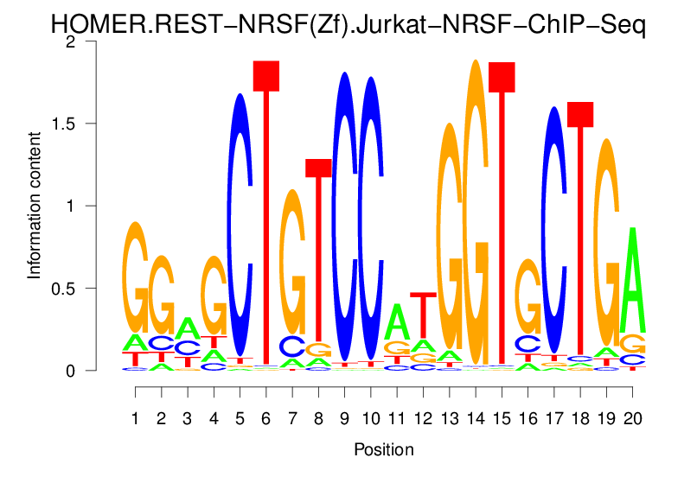
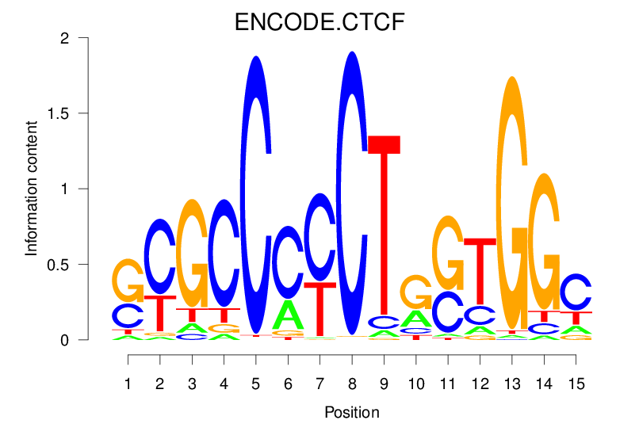
DeepSEA architecture
TF-specific layers
…
Shared fully-connected layers
Shared convolutional layers
ACCGTCGGTATAGGCTTATAAATCTCGGGATACCGTCGGTATAGGCTTATAA

Slide 49
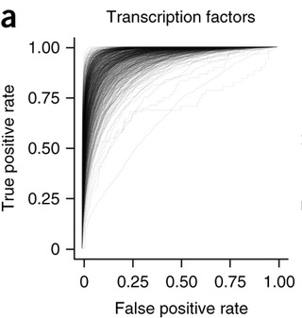
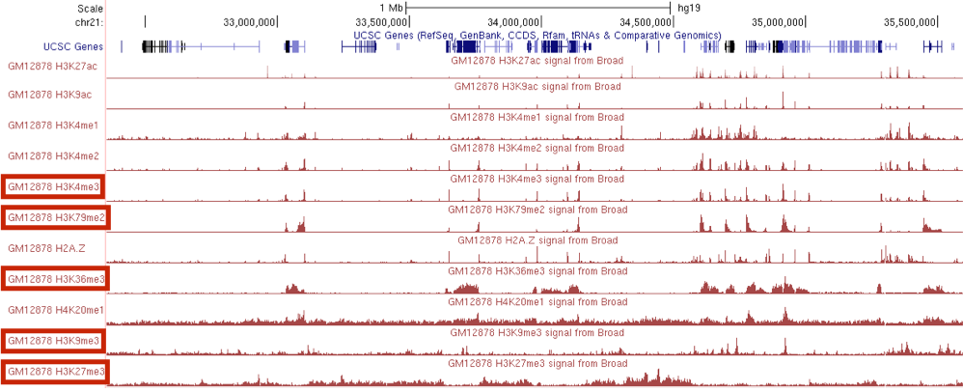
Deep neural network accurately predicts TF binding and DNase hypersensitivity
Reference
sequence
ACCGTCGGTATATCGTCGG
CTCF binding in liver cells (ChIP-seq)
Train
Test
DeepSEA model
Mean AUC: 0.958

Slide 50
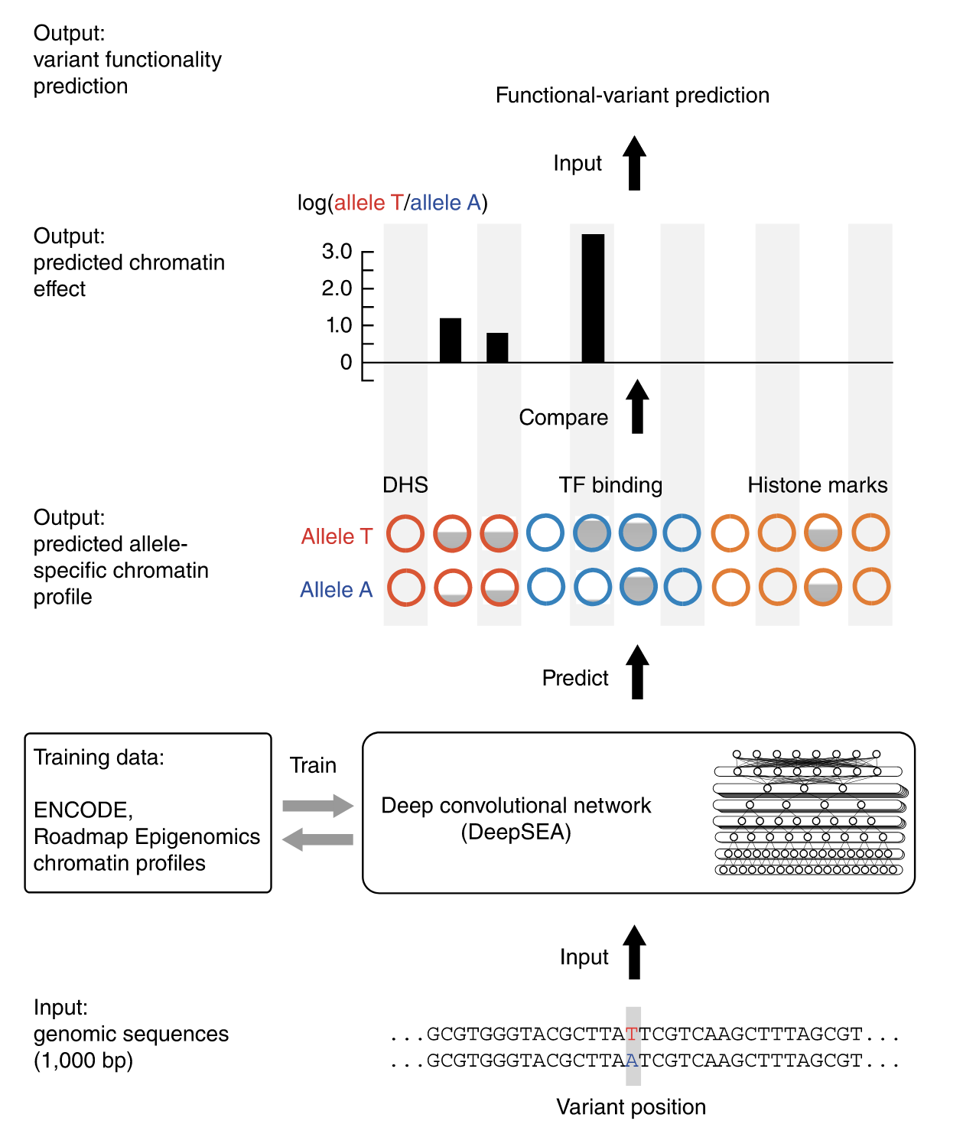
DeepSEA can be used to predict the effect of SNPs

Slide 51
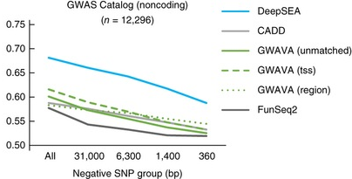
DeepSEA accurately predicts known regulatory variants
Reference
sequence
ACCGTCGGTATATTCGTCCCGTCGGTATAGGCACCGTCGGTATA
Genetic variant
ACCGTCGGTATATTCGTCCCGTCGGTATTGGCACCGTCGGTATA
Trained neural network
Predicted change
in binding strength?
Classification task: annotated regulatory mutation versus nonfunctional variants.
The x axis is the average distance of the positive to its corresponding negative.
Negatives that are very close to positives are harder to distinguish
AUROC

Slide 52
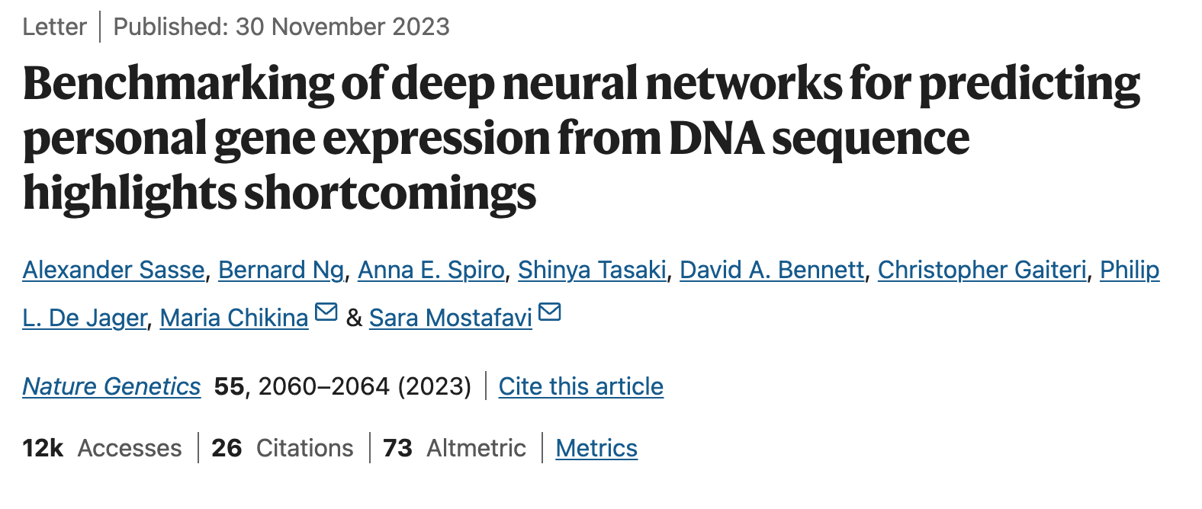
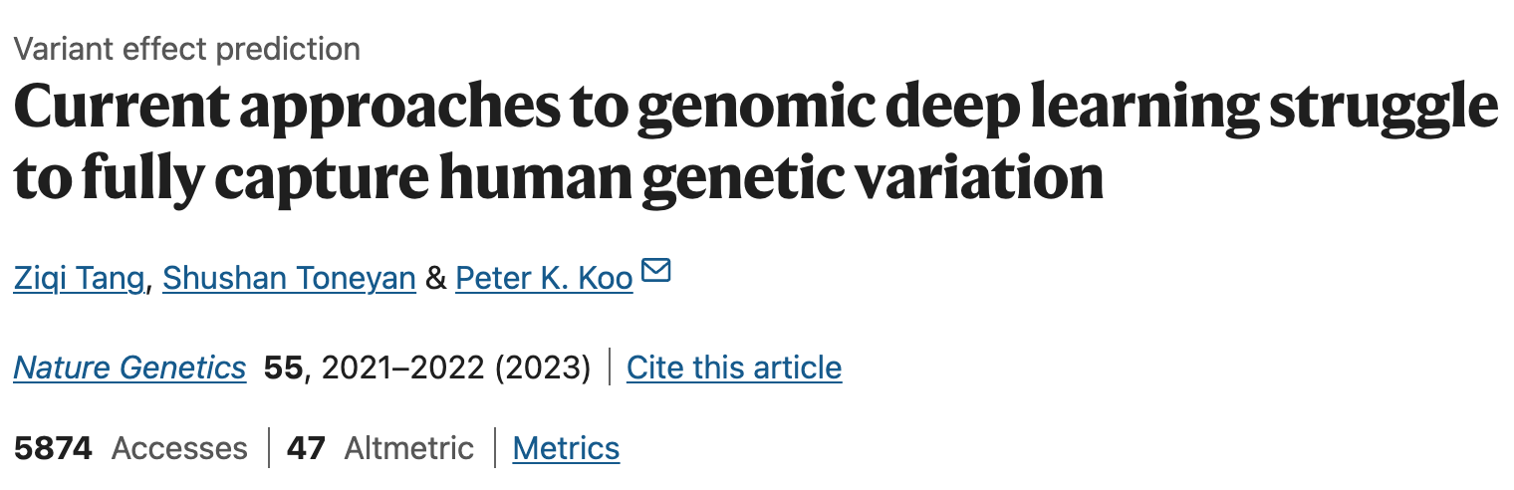
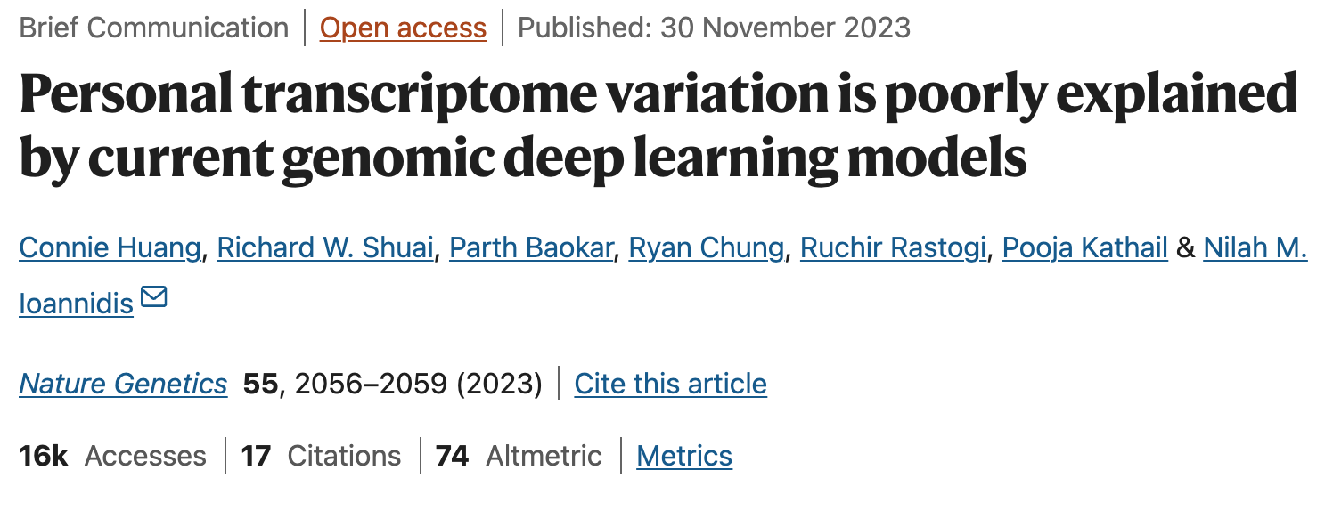
Sequence-to-function models can make implausible predictions
Notes:
But, as we all know models can make inaccurate predictions
There have been a string of recent-ish works that have highlighted how models like Enformer can fail

Slide 53
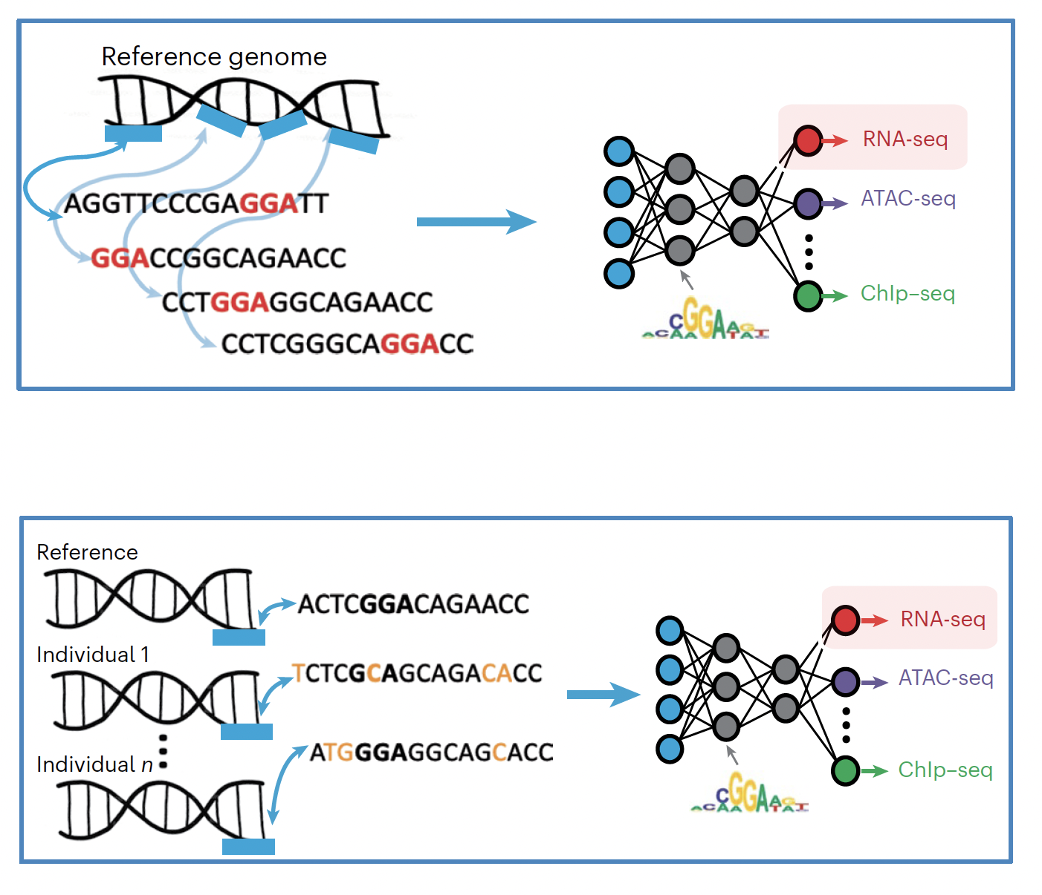
You can train a model from a single reference genome or from individual genomes
Sasse et al. Nature Genetics 2023.

Slide 54
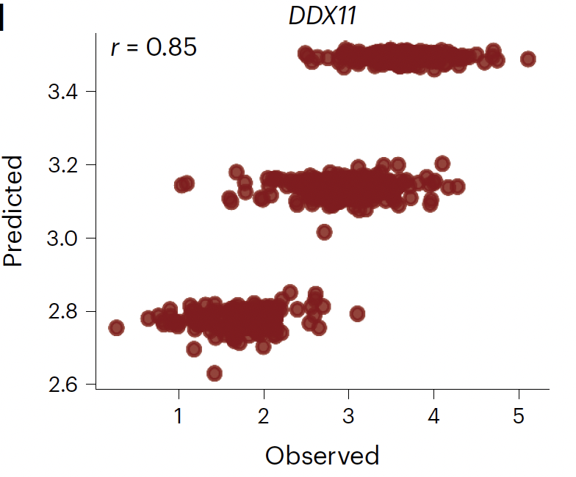
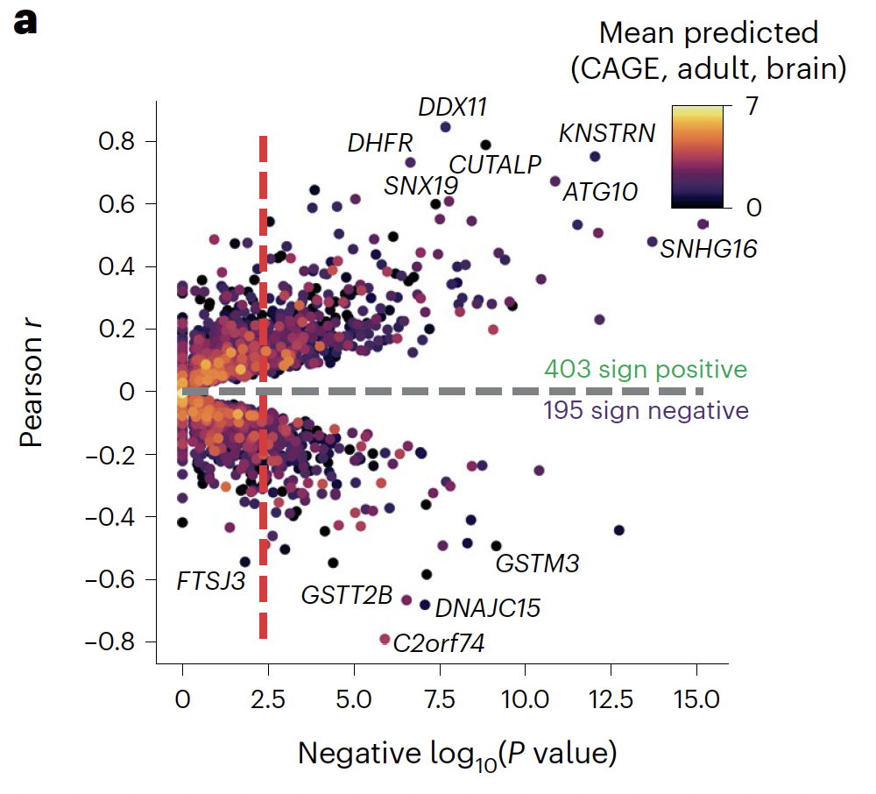
A model trained from the reference genome sometimes works but often fails
Enformer accurately predicts expression associated with three alleles of DDX11
For many genes, Enformer’s correlation is negative
Sasse et al. Nature Genetics 2023.

Slide 55
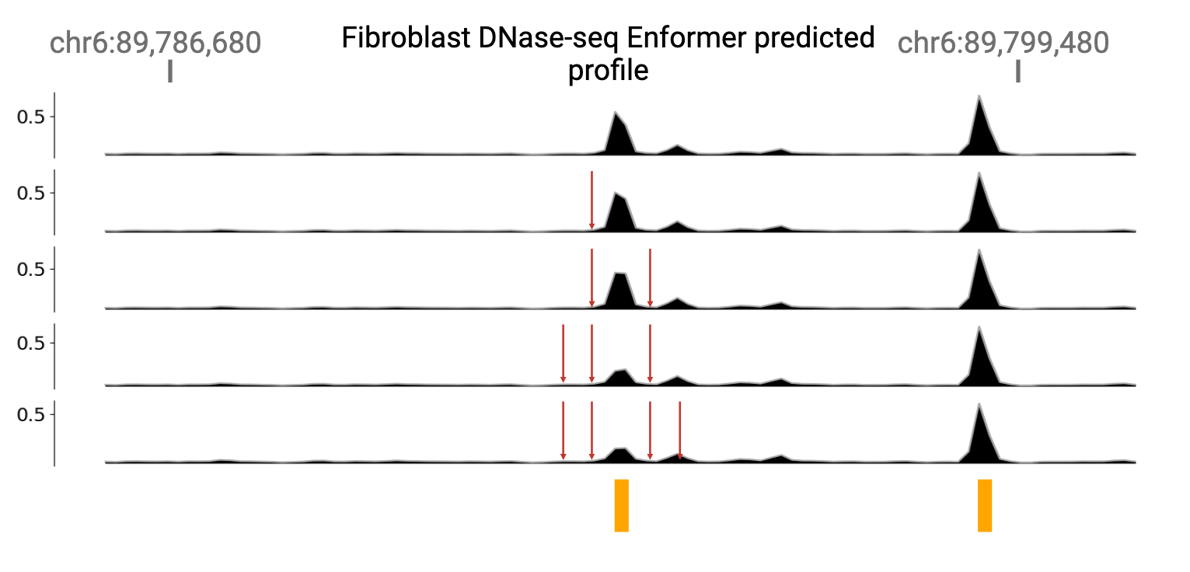
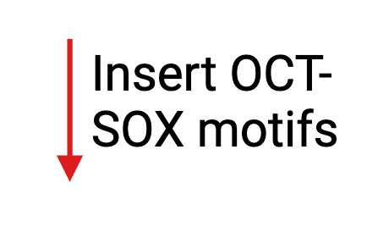
Enformer is sensitive to motif insertion, even for factors that are not expressed in this cell type
OCT4::SOX2 is a cell type specific TFs is not expressed in fibroblasts.
OCT4::SOX2 has never been shown to have a repressive effect on chromatin accessibility.
Notes:
So, one more experiment we can do to investigate feature leakage is motif insertion.
Here I’ve plotted enformers predictions for a fibroblast task. Fibroblasts are a nice example to look at OCT-SOX feature leakage because they famously don’t express it or they would be stem cells.
So, we can insert OCT-SOX motifs near the predicted peak and observe what happens.
We find that, Enformer’s predicts a smaller peak as the motifs are added.

Slide 56
Further reading
If you want more SVM background the Wikipedia page is pretty good: https://en.wikipedia.org/wiki/Support_vector_machine
Neural network background:
https://www.deeplearningbook.org/
Deep Learning: A Visual Approach. It covers a lot of the common neural network architectures, including RNN, transformers, and adversarial networks. It's minimally mathematical (for good and for ill).
https://udlbook.github.io/udlbook/ A bit heavy on theory, but very detailed.
Pytorch background:
https://pytorch.org/tutorials/beginner/basics/intro.html
Deep Learning with PyTorch

